Slide 1
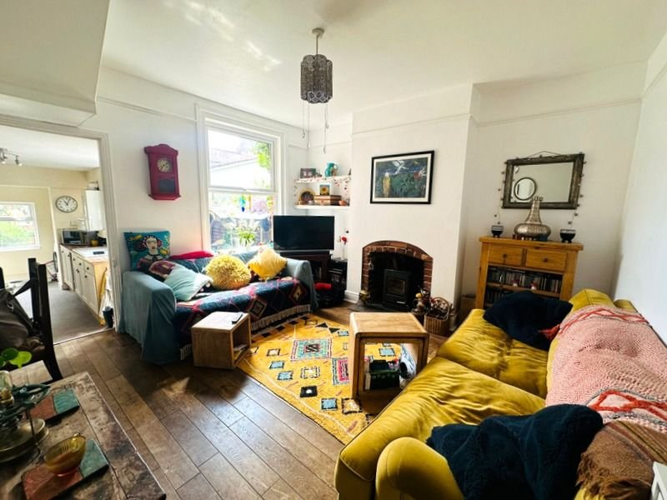
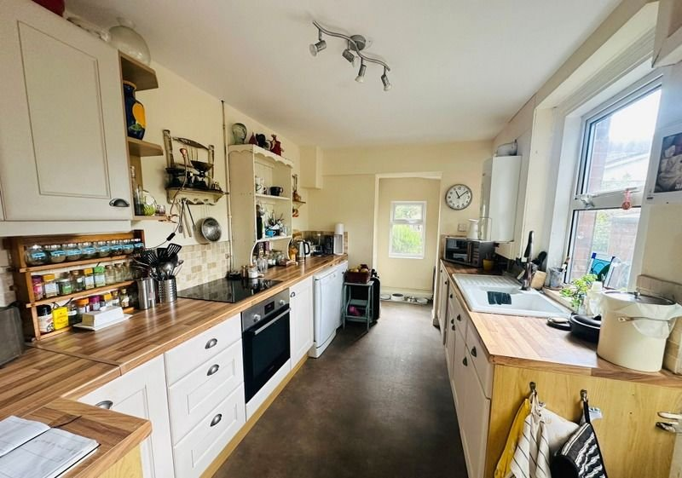
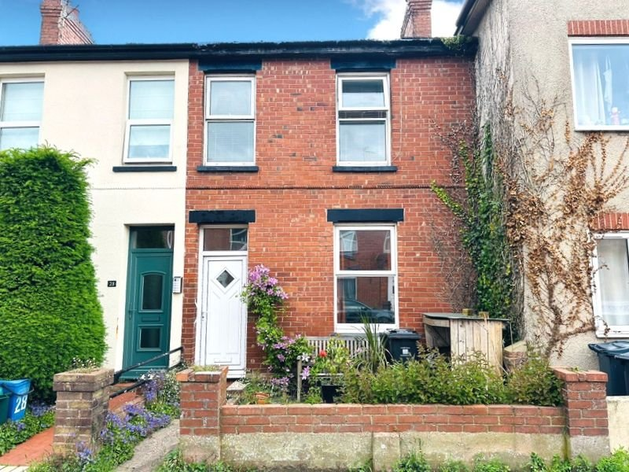
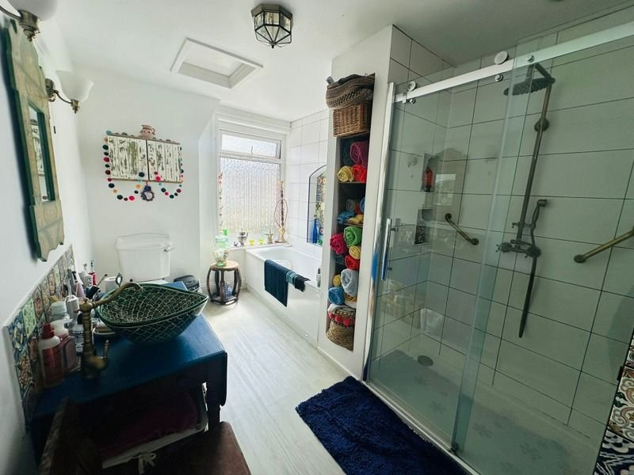
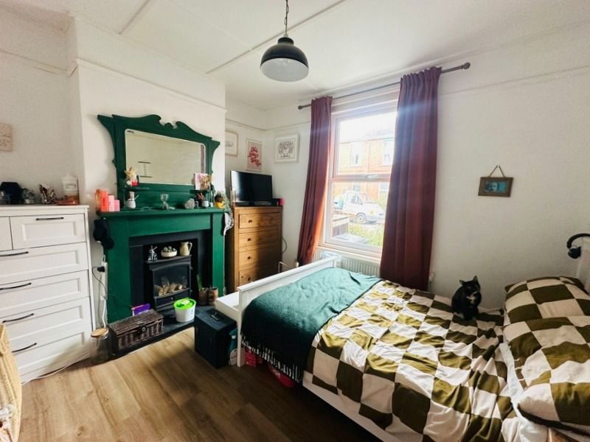
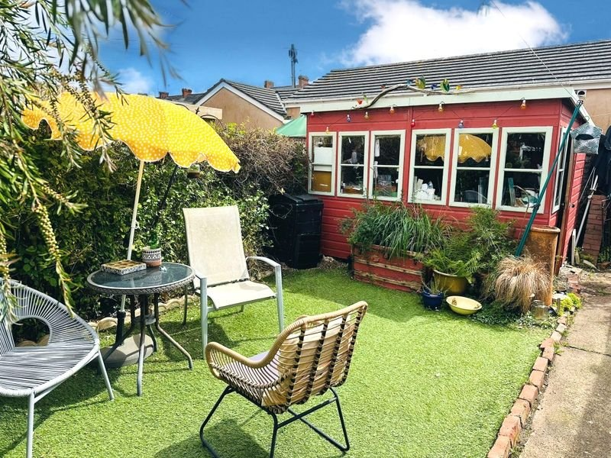
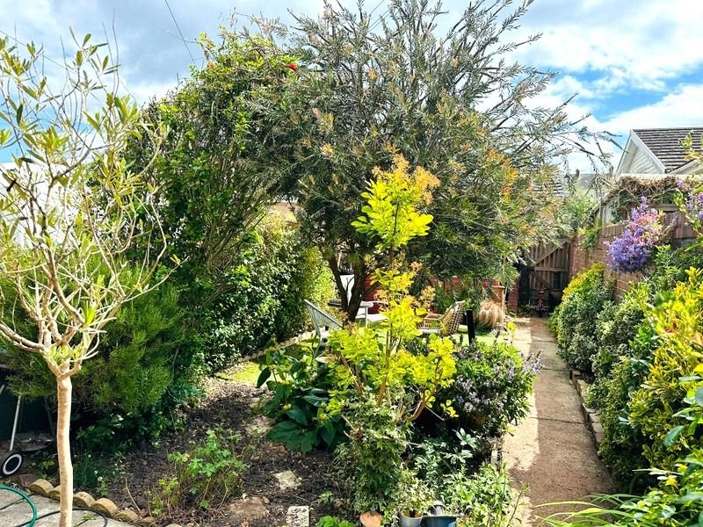
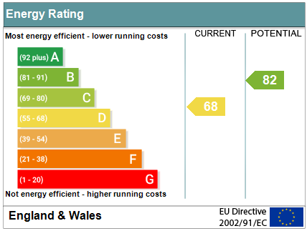
www.pennys.net
26 Egremont Road, Exmouth, EX8 1SA
PRICE £279,000
TENURE Freehold
A Beautifully Presented Terraced House With Attractive Enclosed Rear Garden Located Only A Short Distance From Exmouth Town Centre, Sea Front & Train Station
Entrance Hall • Attractive Open Living Room With Feature Wood Burner •
Separate Dining Room Or Ground Floor Bedroom •
Modern Kitchen & Utility Area • Two First Floor Double Bedrooms •
Generous Family Bathroom / WC • Attractive Good Sized Enclosed Rear Garden •
Double Glazed Windows • Gas Central Heating • Viewing Recommended •
Pennys Estate Agents Limited for themselves and for the vendor of this property whose agents they are give notice that:- (1) These particulars do not constitute any part of an offer or a contract. (2) All statements contained in these particulars are made without responsibility on the part of Pennys Estate Agents Limited. (3) None of the statements contained in these particulars are to be relied upon as a statement or representation of fact. (4) Any intending purchaser must satisfy himself/herself by inspection or otherwise as to the correctness of each of the statements contained in these particulars. (5) The vendor does not make or give and neither do Pennys Estate Agents Limited nor any person in their employment has any authority to make or give any representation or warranty whatever in relation to this property.
PENNYS ESTATE AGENTS
2 Rolle House, Rolle Street, Exmouth, Devon, EX8 2SN
Tel: 01395 264111 EMail: help@pennys.net

Slide 2
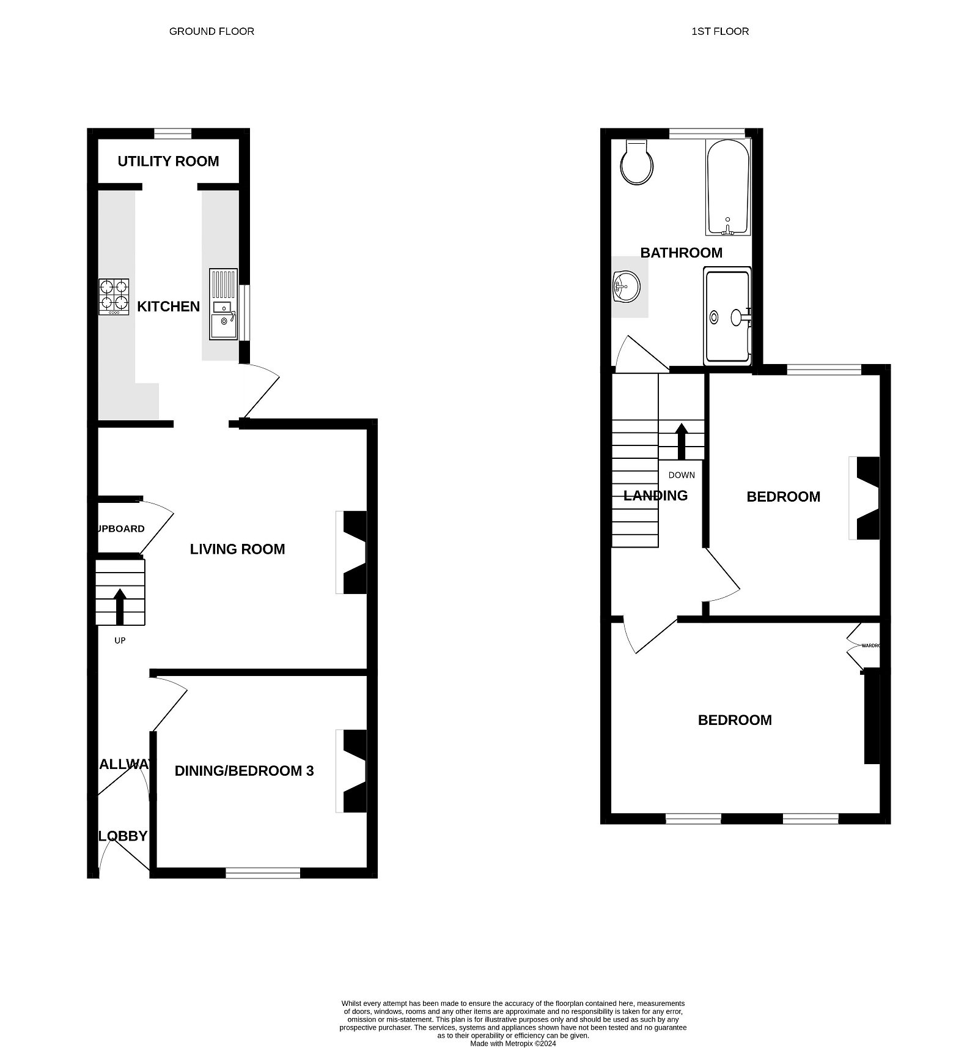
26 Egremont Road, Exmouth, EX8 1SA
THE ACCOMMODATION COMPRISES: With uPVC double glazed front door with inset patterned glass panel giving access to: ENTRANCE LOBBY: With high level electric meter boxes; wooden door with patterned effect glass opening too: ENTRANCE HALLWAY: With stairs rising to first floor; radiator; oak flooring; opening through to: LIVING ROOM: 4.65m x 3.96m (15'3" x 13'0") Maximum measurement; A beautiful light and airy sunny aspect room with feature Dual Fuel wood-burner with partial exposed brick chimney and slate hearth; with uPVC double glazed window overlooking the rear garden; alcove shelving; useful understairs recess ideal for a small table or study area; further understairs storage cupboard; radiator; telephone point; TV point; power points; ceiling light; continued oak flooring. DINING ROOM/GROUND FLOOR BEDROOM THREE: 3.53m x 3.23m (11'7" x 10'7") Measurement in to chimney recess; (currently being used as a bedroom) with uPVC double glazed window to front aspect; feature gas stove with slate hearth; central ceiling rose and light; radiator; power points; LVT wood effect flooring. KITCHEN: 4.88m x 2.44m (16'0" x 8'0") Maximum measurement into the Utility Area. A modern fitted kitchen with wood effect roll edge worktop and fully tiled splashbacks; range of shaker style effect cupboards and drawer units; integrated BOSCH electric oven and matching induction hob over; inset ceramic one and a half bowl sink unit with mixer tap over; space and plumbing for undercounter dishwasher and fridge/freezer; matching range of eye-level wall units; wall mounted Worcester combi boiler; uPVC double glazed window to side aspect; further single glazed window; vinyl flooring; power points; uPVC double glazed door with leaded effect glass to rear garden; opening through to: UTILITY AREA: With uPVC double glazed window overlooking the rear aspect; appliance space for upright standing fridge/freezer; plumbing for an automatic washing machine; appliance space for tumble dryer above; continued vinyl flooring; ceiling spotlight. FIRST FLOOR HALF LANDING: With wooden door to: BATHROOM WITH SHOWER/WC: 3.78m x 2.24m (12'5" x 7'4") A lovely bright, larger than average room with a beautifully fitted suite comprising of original bath; with feature inset mosaic style splashback and shelf; antique brass mixer taps and shower head attachment over; fully tiled walls; uPVC obscure glazed window to rear aspect; low level spotlights; useful full height storage area; enclosed shower cubicle with sliding screen; inset shelving with lighting; antique brass rainfall shower unit and grab rail; fully tiled surrounds; extractor fan; further tiled shelf; fitted unit with ceramic patterned free standing sink with mosaic tiled splashback; two pull cord sidelights; shaver socket; access to partial loft space; WC; heated towel rail. FIRST FLOOR LANDING: With access to partially boarded loft space via pull down ladder with light connected; radiator; single glazed high level window, doors to:
BEDROOM ONE: 4.57m x 3.23m (15'0" x 10'7") Measurement in to the alcoves; with fitted shelving; fitted wardrobe with hanging space and shelving; two uPVC double glazed windows to the front aspect; radiator; power points, central ceiling light. BEDROOM TWO: 4.01m x 2.9m (13'2" x 9'6") With uPVC double glazed window overlooking the rear garden; partial exposed brick fireplace; radiator; ceiling lights; power points. OUTSIDE: To the front of the property there is a small artificial lawn area with brick wall boundaries with pathway leading to front entrance door. To the rear there is a beautifully presented and sunny aspect enclosed level rear garden which comprises artificial lawned area ideal for outside entertaining; flower tree and shrub borders. SUBSTANTIAL WORKSHOP which is fully insulated with power measuring 10"x10" ideal for a hobbies room; timber garden gate to rear access lane; outside water tap; outside sockets.
FLOOR PLAN:

